Slide 1

VOTING WEB APPLICATION USING
DJANGO FRAMEWORK

Slide 2
OVERVIEW ABOUT THIS PROJECT
This project harnesses Django's robust framework to launch a versatile voting web application, enabling users to effortlessly create polls, vote,and view instant results.
Tailored for a broad spectrum of uses, from community decisions to entertainment votes, it showcases our adept use of Django build secure, user-friendly interfaces.
The initiative is not only underscores our technical prowess but also our dedication to enhancing participatory decision-making.

Slide 3
APPLICATIONS
This application offers a streamlined platform for conducting a variety of polls, from community decisions to entertainment preferences enabling users to cast votes and see results in real time.
Built with a focuson user engagement and security, it ensures a transparent and accessible voting process for all participants.
This innovative tool is designed to facilitate democratic engagement and decision-making across diverse groups, fostering a participatory culture in any setting.

Slide 4
LANGUAGES USED
FRONT END : HTML,CSS,JS
BACKEND :DJANGO,PYTHON,
SQL

Slide 5
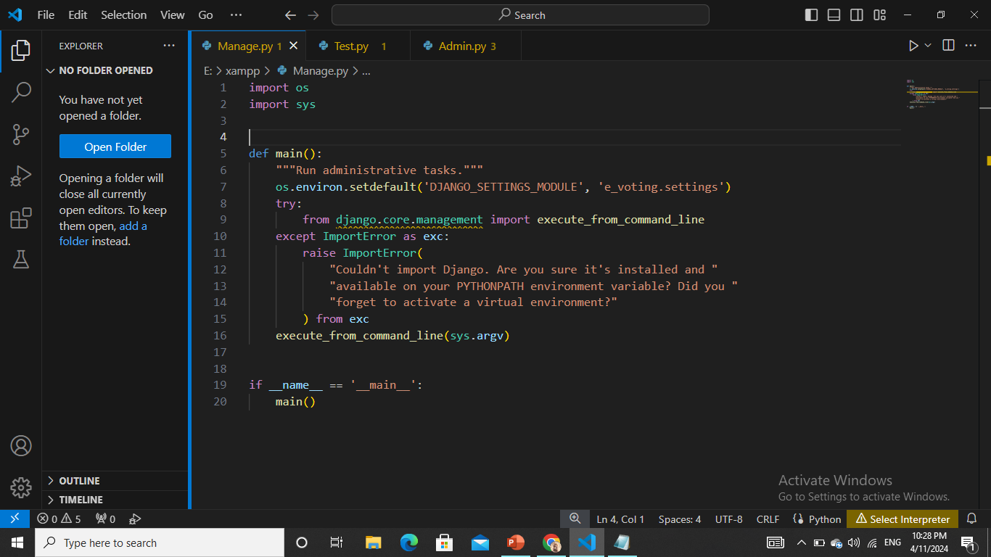

Slide 6
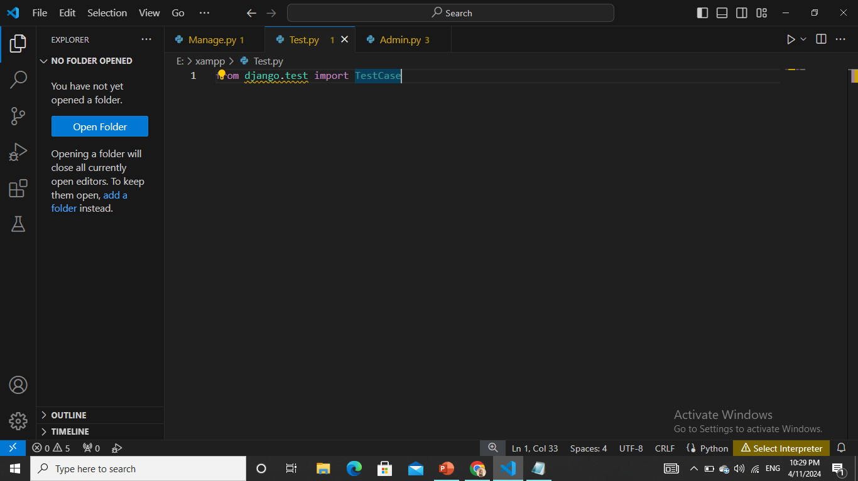
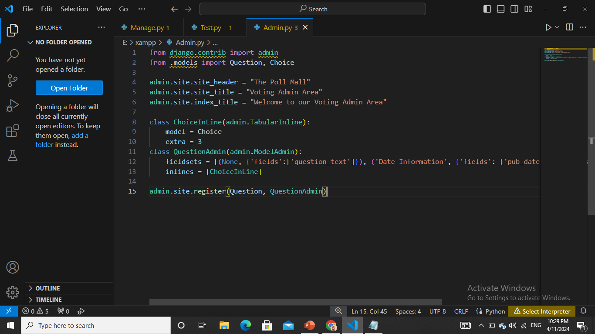

Slide 7
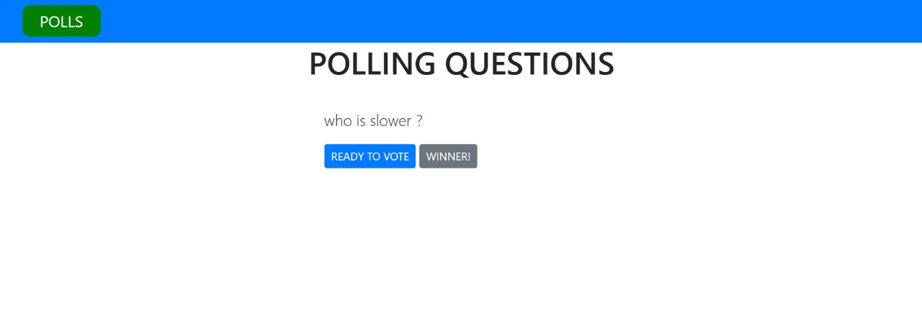
OUTPUT

Slide 8
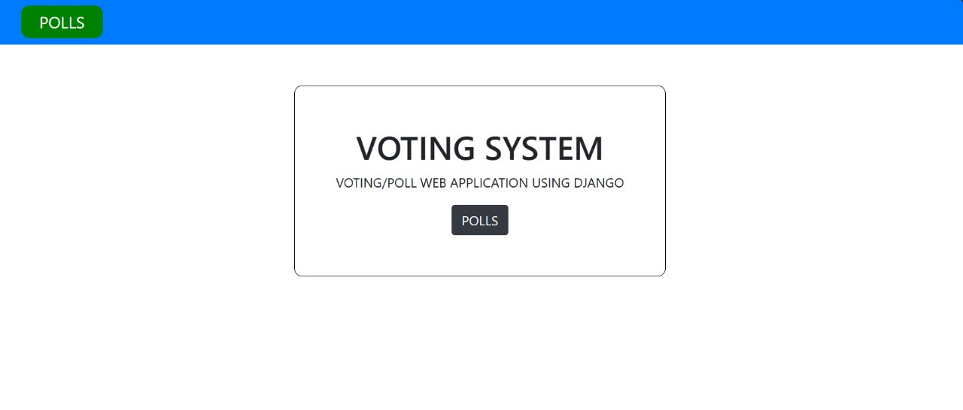

Slide 9
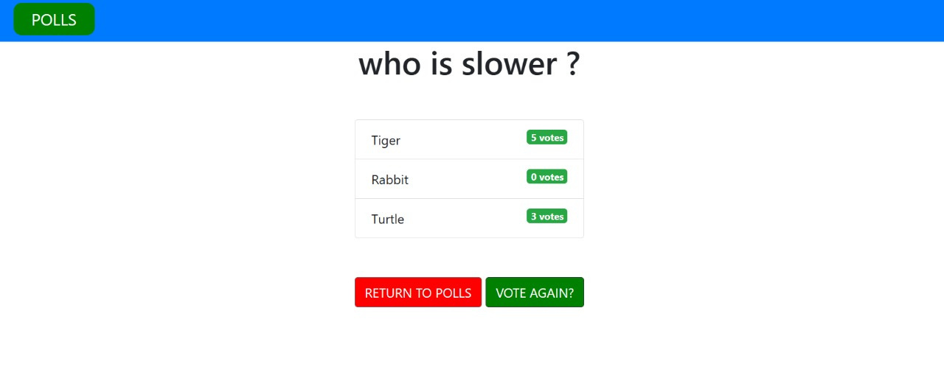

Slide 10
THANK YOU

